Slide 1

Team Name : GramScore AI by AIMaverick
Team Leader Name : Rohit Kumar Akula
Problem Statement :
Over 60% of rural India lacks access to fair and timely credit because traditional scoring systems ignore seasonality, climate volatility, and informal livelihoods. As a result, deserving borrowers are denied loans, while lenders face rising NPAs due to blind risk assessment. India needs an AI-powered, explainable rural credit intelligence system that understands ground realities — not just credit history.

Slide 2


GramScore AI – Climate-Aware Credit Intelligence for Bharat
GramScore AI is an AI-powered alternative credit intelligence platform built specifically for rural India.
It combines climate data, crop cycles, mandi price trends, and livelihood signals to assess real repayment capacity — not just credit history.
Using explainable AI, it generates transparent and actionable credit risk scores that help financial institutions lend faster, safer, and more inclusively.
What It Enables:
Smarter rural loan approvals
Reduced NPAs through contextual risk assessment
Faster underwriting decisions
Financial inclusion at scale

Slide 3

Existing Systems:
Urban credit bureau dependent
Ignore seasonality
Ignore crop risks
Not explainable
Our Solution:
Climate-aware
Crop-cycle-aware
Explainable AI
Designed for rural India
API-first scalable infrastructure
USP
Contextual rural intelligence + explainable AI + scalable fintech integration

Slide 4

List of features offered by the solution
Alternative credit scoring
Climate risk impact modeling
Seasonality-adjusted repayment capacity
SHAP-based explainability
Loan officer dashboard
Risk simulation tool
API integration support

Slide 5
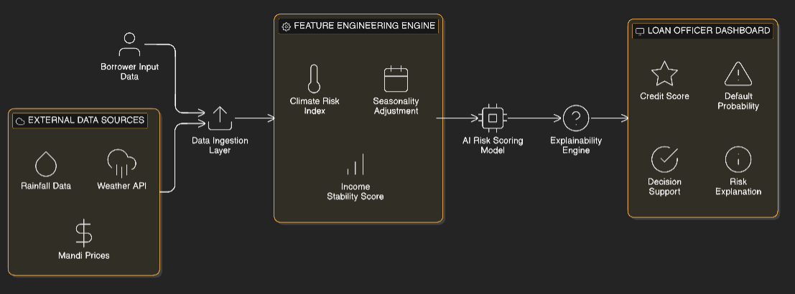
Process flow diagram or Use-case diagram

Slide 6
Wireframes/Mock diagrams of the proposed solution (optional)

Slide 7
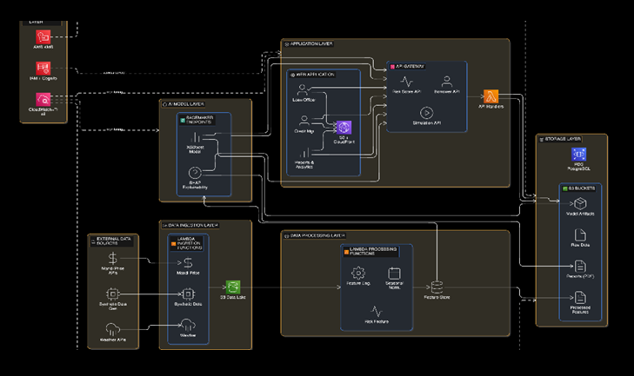
Architecture diagram of the proposed solution: Attached the architecture details png file in the GitRepo for reference.

Slide 8
Technologies to be used in the solution:
Python
XGBoost
SHAP
AWS SageMaker
AWS Lambda
RDS
React (Dashboard)
REST APIs

Slide 9
Estimated implementation cost (optional):
Hackathon MVP (Cloud Credits / Sandbox Mode):
      ~₹50,000 - ₹1,00,000 equivalent cloud infrastructure cost
Pilot Deployment (Single Bank / 5 Branches):
~ ₹3–5 lakh initial setup cost
Scalable SaaS Model:
Operational cost scales per API usage (~₹30–₹50 per assessment)
One avoided NPA can offset the cost of over 10,000 credit assessments.

Slide 10
Add as per the requirements for the hackathon:

Slide 11


